Slide 1

SIME DARBY PROPERTY UNIVERSITY HACKATHON 2026 · PLANET TRACK
CircularFit
Don’t skip it. Share it.
Routing handover renovation waste to a neighbour, a salvage partner or a recycler, before landfill.
Team name
Team leader
University
Members (3 to 5)
Email and phone
[fill in]
[fill in]
[fill in]
[fill in]
[fill in]
Notes:
Introduce the team and the idea in one breath: CircularFit keeps handover renovation waste out of skip bins. Fill in the team details on this slide before presenting.

Slide 2
1 · THE PROBLEM
Every handover starts
a renovation rush
Hundreds of homes are handed over in one precinct
~16%
of materials used in housing becomes waste
Owners strip out sinks, doors, cabinets and spare tiles, often unused
~32%
of that waste could be reused or recycled
It all goes into skip bins, then landfill
Landfill space in Malaysia is already tight
8.8 Mt
of housing waste a year in Malaysia (estimate)
Sources: Ain Shams Engineering Journal (2021); UTHM study on construction waste and landfill space
2 / 10
Notes:
Set the scene. When hundreds of homes are handed over in one precinct, many owners start renovating straight away and strip out sinks, doors, cabinets and leftover tiles that are often brand new. All of it goes into skip bins. The numbers are a Malaysian housing-sector estimate: about 16 percent of materials used become waste, and about a third of that could be reused or recycled. Say clearly that these are estimates. Evidence to add if you can: a few quick interviews with new homeowners or renovation contractors on how soon they renovate and what they throw away.

Slide 3
2 · TARGET USERS
Three people, one shared problem
R
N
T
Resident or contractor
Neighbour
Township management
Wants a quick, free way to clear strip-out without extra skip bins.
Needs a few tiles, a door or a sink, and would rather not buy new.
Needs less waste, sustainability numbers and a plan for the next handover wave.
GETS
GETS
GETS
A one-minute log and green points
Free materials close to home
A planner, a routing console and a ledger
CircularFit · Planet track
3 / 10
Notes:
Three groups share the problem. Residents and contractors are the donors. Neighbours are the requesters. Township management is the customer and the admin. Also involved but not shown: a salvage partner, a recycler and guardhouse staff. Stress that the township is the buyer: it gets the numbers, the planner and the routing console.

Slide 4
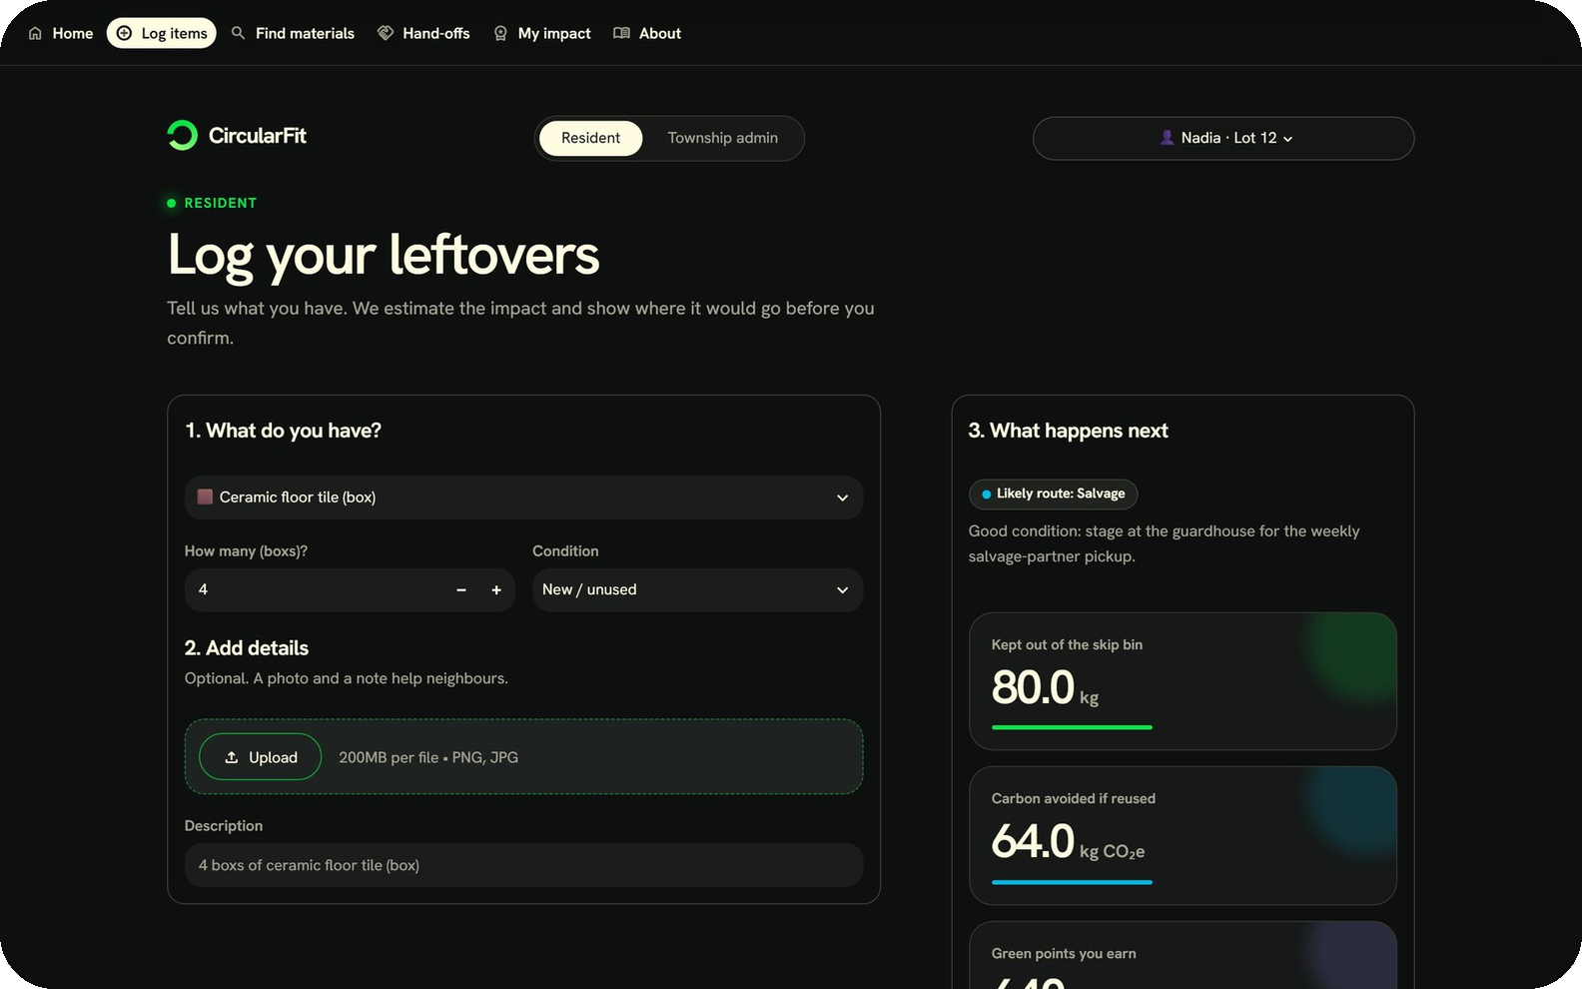
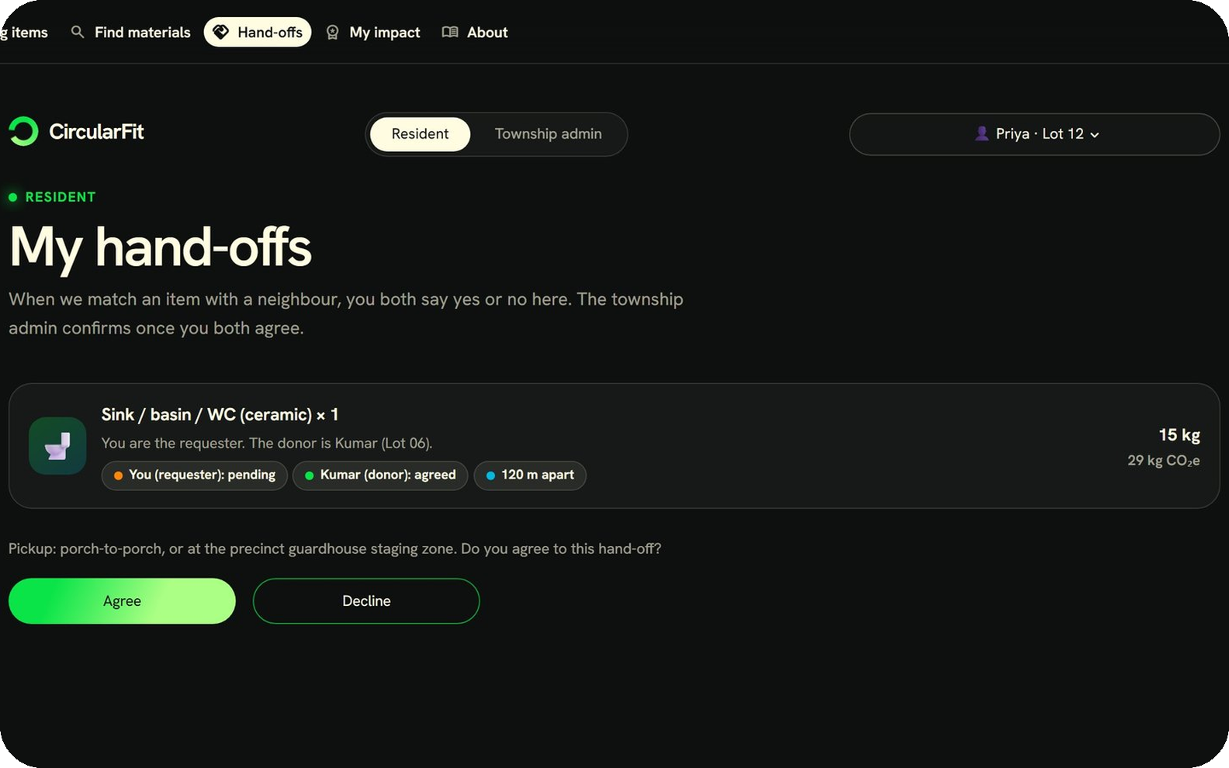
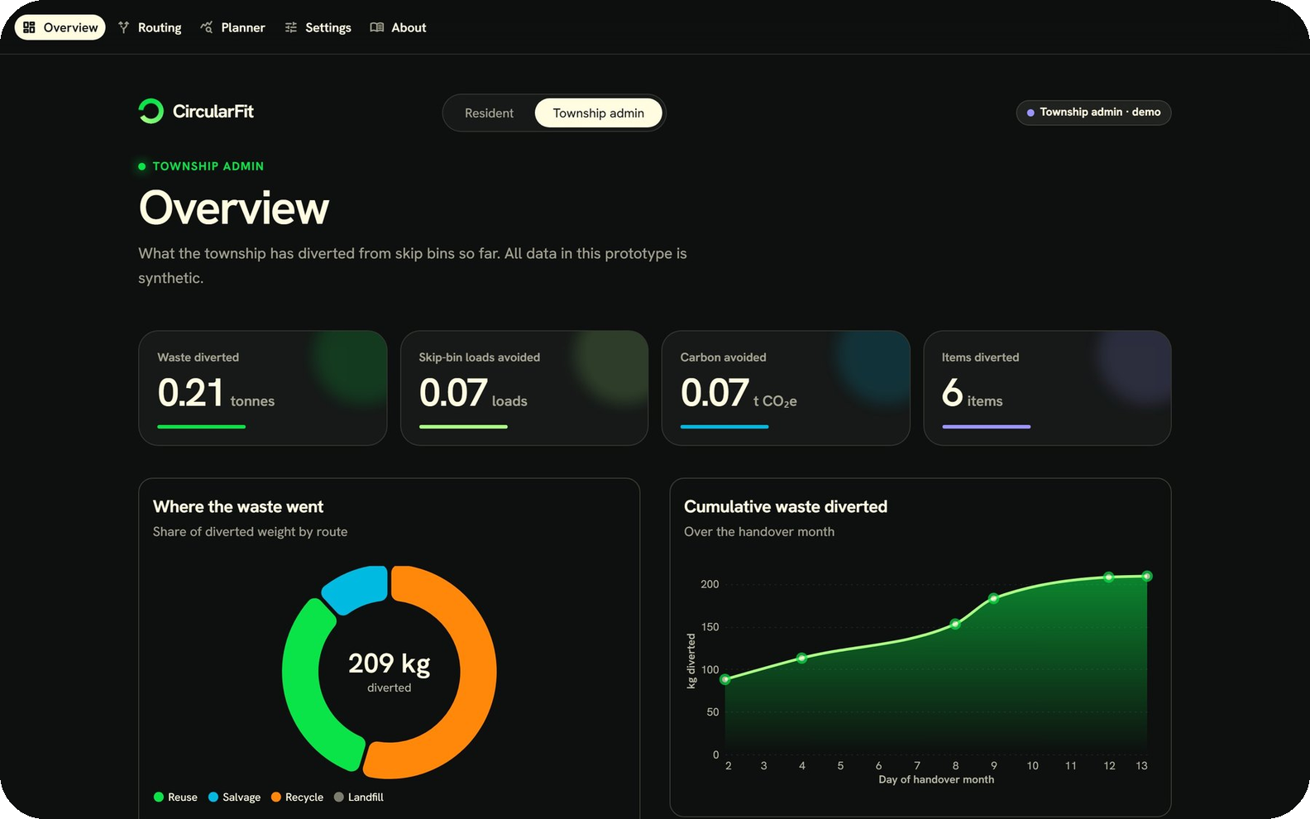
3 · THE SOLUTION
Log it. Route it. Prove it.
Log
Agree
Prove
A resident logs leftovers and sees the likely route first.
Donor and requester each say yes or no on their own page.
The admin confirms, and the ledger feeds the dashboard.
Screens from the working prototype (synthetic data)
4 / 10
Notes:
CircularFit sends each strip-out item to the best available route: reuse with a neighbour, salvage through the guardhouse staging zone, recycle, and landfill only as a last resort. These are real screens from our prototype. A resident logs an item and sees where it would go. The donor and the requester each agree on their own page. The township admin confirms, and every confirmed hand-off lands in a ledger that feeds the dashboard.

Slide 5
4 · INNOVATION
Not another marketplace
What changes | Today | With CircularFit
Where strip-out goes | Skip bin, then landfill | Best route first, landfill last
Who sees the numbers | Nobody | Township dashboard and ledger
Planning the next wave | Guesswork | Handover planner
Resident incentive | None | Green points
Proof it happened | None | Two-sided agreement, admin confirms
Waste-hierarchy routing
Hyper-local
Handover planner
Auditable ledger
Decided per item, not per listing
Matched within a few hundred metres
Forecasts waste for a whole precinct
Only confirmed hand-offs count
CircularFit · Planet track
5 / 10
Notes:
Today the strip-out goes into a skip bin and nobody counts it. CircularFit changes four things: it routes each item up the waste hierarchy, it keeps matching hyper-local, it gives the township a planner for the next handover wave, and it only counts hand-offs that both residents agreed to and the admin confirmed. If a judge asks about marketplaces and leftover-material platforms: those list items for sale or swap, while CircularFit is a routing and reporting system for the developer. Check any specific competitor claim before you say it out loud.

Slide 6
5 · HOW IT WORKS
Six steps from strip-out to ledger
Log
Estimate
Route
1
2
3
Material, quantity, condition
Weight and carbon from a catalogue
The first route that applies wins
Agree
Confirm
Report
4
5
6
Donor and requester say yes or no
Admin confirms after both agree
Ledger, dashboard and points
Reuse
Salvage
Recycle
Landfill
A neighbour asked for it
Staged for weekly pickup
Collected by a recycler
Only as a last resort
Reuse match score: 40% material · 25% distance · 20% wording · 15% quantity
6 / 10
Notes:
Walk left to right and top to bottom. A resident logs an item. We estimate its weight and carbon from a materials catalogue. Routing picks the first route that applies: reuse if a neighbour asked, then salvage through the guardhouse staging zone, then recycle, and landfill last. For reuse, the donor and requester each agree on their own page, and only then can the admin confirm. The match score is a ranking aid: 40 percent material, 25 percent distance, 20 percent wording overlap and 15 percent quantity. The admin makes the final call.

Slide 7
6 · IMPACT
One handover wave,
tens of tonnes diverted
Planning scenario: 300 homes · 60% renovating · 900 kg each · 30% of divertible waste captured
162
52
5.2
10.9
tonnes of renovation waste expected
tonnes divertible (32%)
of 54 skip-bin loads avoided
tonnes CO₂e avoided (estimate)
Township: less waste to haul, numbers to report
Residents: free materials and green points
Environment: less landfill, less new material
All inputs are assumptions. Replace waste per home with precinct data in a pilot.
7 / 10
Notes:
This is a planning scenario from our Handover Planner, not a measured result. We assumed 300 homes, 60 percent renovating, 900 kilograms of waste each, and 30 percent of the divertible share captured. That gives about 162 tonnes of waste, about 52 tonnes divertible, and about 15 tonnes actually diverted, which avoids roughly 5 of 54 skip-bin loads and about 11 tonnes of CO2e. Say plainly that the divertible share comes from a Malaysian housing-sector estimate and that a pilot would replace waste per home with real precinct data. The township gets numbers it can report, residents get free materials and points, and less new material is produced.

Slide 8
7 · FEASIBILITY
It already runs
Risk | How we handle it
Low adoption | Launch at handover, add green points
Contractors prefer skip bins | Quick batch listing for a whole strip-out
Safety of used fixtures | Condition check and a no-warranty notice
Batches too small to collect | Staging zone and a recycler minimum
What exists today
✓
Working prototype in Python and Streamlit
✓
Full loop: log, route, agree, confirm, report
✓
No proprietary data needed
✓
Carbon factors from public databases
!
Needs guardhouse space, a salvage partner, a recycler and JMB support
CircularFit · Planet track
8 / 10
Notes:
This is not a slide idea, it is a running prototype with the full loop. It needs no proprietary data, and the carbon factors come from public databases or are clearly labelled assumptions. On the ground we need a staging area at the guardhouse, a salvage partner, a recycler and support from the Joint Management Body. The four main risks are adoption, contractor habits, safety of used fixtures and small batches, and each has a simple mitigation.

Slide 9
8 · IMPLEMENTATION
Pilot one handover wave, then scale
PHASE 0 · WEEKS 0–4
PHASE 1 · WEEKS 5–16
PHASE 2 · NEXT
PHASE 3 · LATER
Agree and baseline
Run one wave
Township rollout
Beyond one township
Pick the pilot precinct
Agree staging space and partners
Measure waste per home today
Resident and admin roles live
Track tonnes, bins and carbon
Tune routing rules and rewards
Real sign-in from handover records
Reminders and QR check-in
Regular partner pickups
Other developers
Townships across Malaysia
A shared partner network
Developer: sponsor, staging space
JMB: resident access
Partners: collection
Admin: daily operation
Timeline is a proposal for discussion with the developer
9 / 10
Notes:
We do not ask for a big rollout. We propose one handover wave in one precinct. Phase 0 agrees the precinct, the staging space and the partners, and measures waste per home today. Phase 1 runs a wave with both roles live and tracks tonnes, skip-bin loads and carbon. Phase 2 extends across the township with real sign-in, reminders and a QR check-in. Phase 3 offers the model to other developers and townships. The timeline is a proposal, so be open to adjusting it with Sime Darby Property mentors.

Slide 10
WHY OUR TEAM SHOULD WIN
CircularFit turns the handover renovation rush into a measurable circular-economy programme. Instead of another marketplace, it routes every strip-out item up the waste hierarchy, to a neighbour, a salvage partner or a recycler, before landfill. Residents log and agree in minutes. Township management gets a handover planner, a routing console and an auditable ledger of tonnes, skip bins and carbon avoided. It is built on Sime Darby Property’s own handover moment, scales to any Malaysian township, and our working prototype already runs the full loop.
Thank you
[Team name]
[Email · phone]
CircularFit · Planet track
10 / 10
Notes:
Read or paraphrase the paragraph; it is 85 words, inside the 100-word limit. Close on the three ideas: routing instead of listing, a ledger the township can trust, and a prototype that already works. Then thank the judges. Fill in the team name and contact details before presenting.

Slide 11
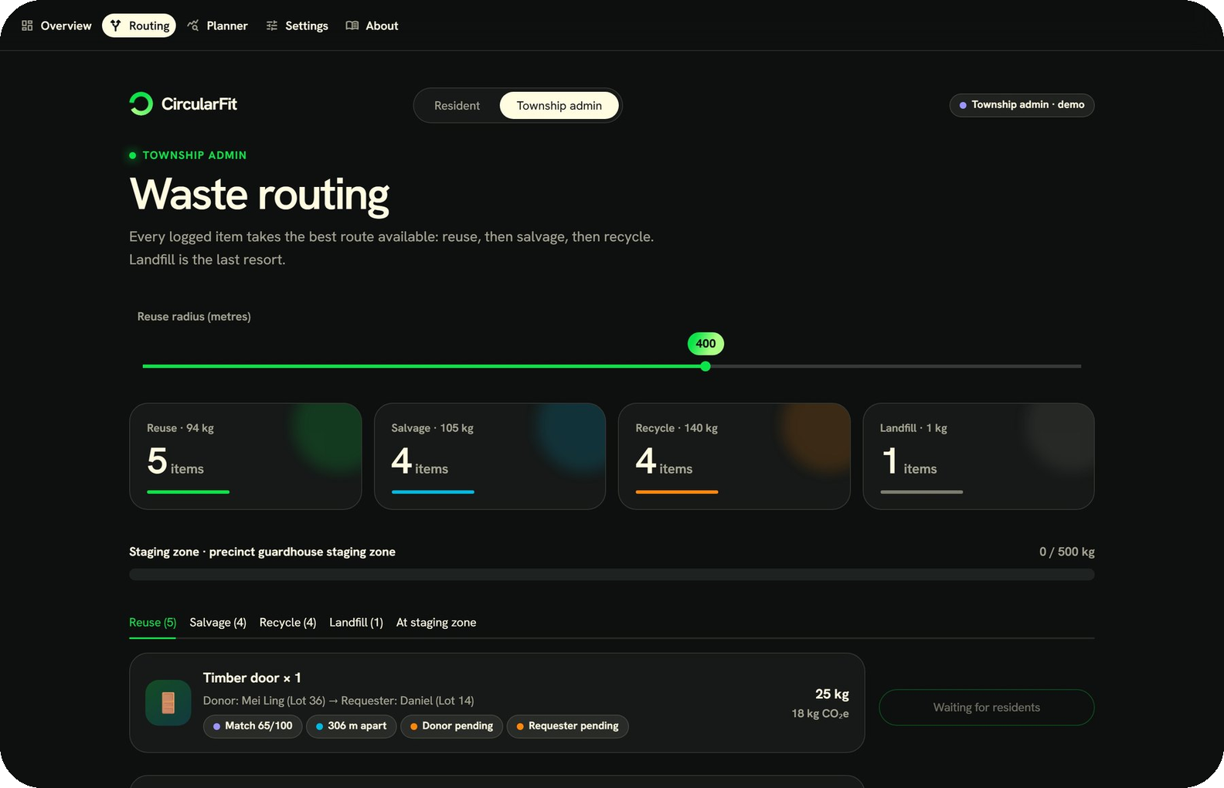
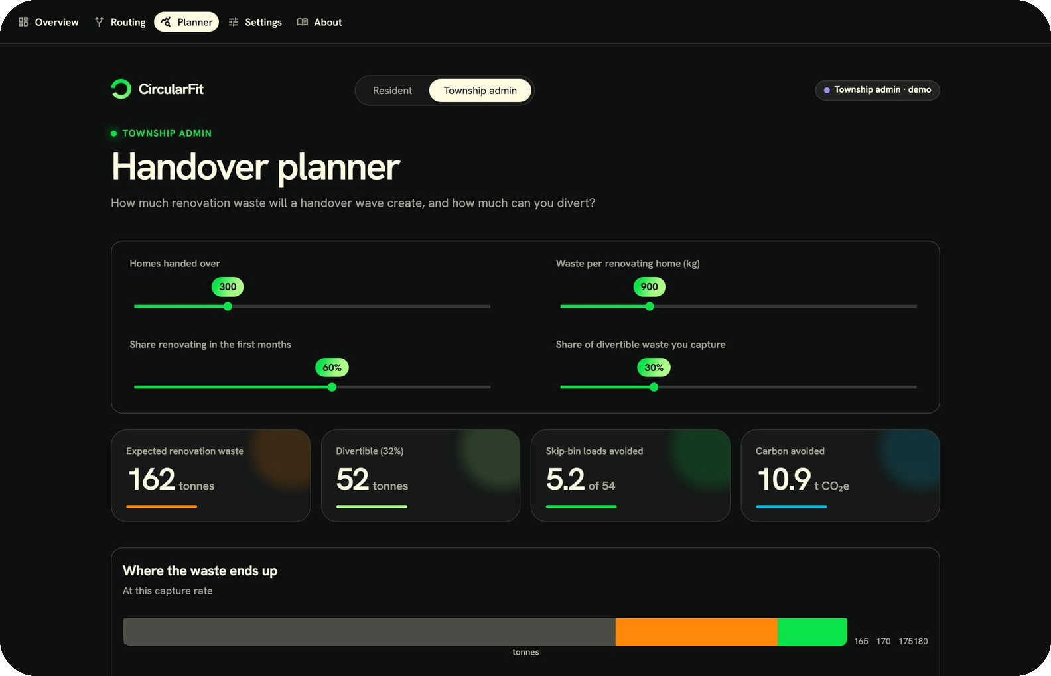
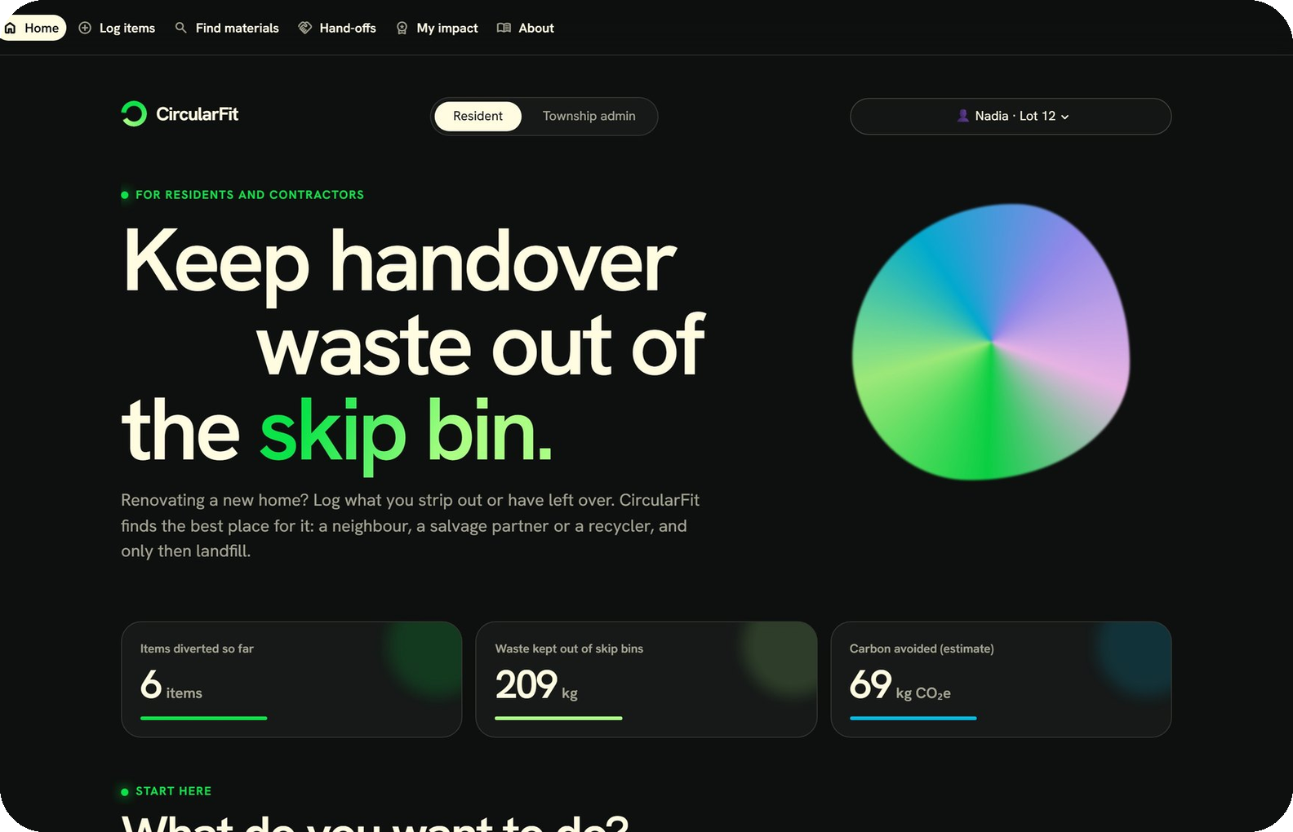
APPENDIX A1 · VISUAL CONCEPT
Inside the prototype
Routing console
Handover planner
Resident home
Admin sees both residents’ answers before confirming.
Forecasts waste, skip-bin loads and carbon for a precinct.
Three clear next steps and the township’s running totals.
Screens from the working prototype (synthetic data)
A1
Notes:
Extra screens for the visual concept slide: the routing console, the handover planner and the resident home. All data shown is synthetic.

Slide 12
APPENDIX A2 · METHOD
How carbon avoided is estimated
carbon avoided = weight × emission factor × condition credit × route credit
Material | kg per unit | kg CO₂e per kg | Source
Ceramic floor tile (box) | 20 | 0.80 | ICE v4 factor, weight assumed
Porcelain tile (box) | 22 | 0.76 | ICE v4 factor, weight assumed
Sink, basin or WC (ceramic) | 15 | 1.93 | ICE v4 factor, weight assumed
Timber door | 25 | 0.70 | Placeholder, to verify
Kitchen cabinet (wood-based) | 30 | 0.90 | Placeholder, to verify
Tap or faucet (brass) | 1.2 | 3.00 | Placeholder, to verify
Condition credit: new 100%, good 80%, fair 50%. Route credit: reuse 100%, salvage 80%, recycle 15%, landfill 0%. Production stage (A1–A3) only; transport and end-of-life are ignored.
Rows marked placeholder are guesses to be replaced with cited values
A2
Notes:
This is the full carbon method. Tile and sanitaryware emission factors come from the ICE database version 4, cradle to gate. Other databases give higher values, so name the one you use. The weights per unit and the factors for doors, cabinets and taps are placeholders and are labelled as such. The condition and route credits are assumptions the township can change on the Settings page.

Slide 13
APPENDIX A3 · ROLES
Two roles, one agreement flow
1
2
3
4
Match proposed
Both agree
Admin confirms
Ledger and points
The system ranks donor and requester pairs
Each resident says yes or no on their own page
A second pop-up with a tick box
Only confirmed hand-offs count
A decline by either resident sends the item back to routing.
Resident
Township admin
Log items, find materials, agree or decline hand-offs, see points
Routing, confirm hand-offs, planner, settings, dashboard
Roles are a demo switch in the prototype; a live version needs real sign-in
A3
Notes:
This is the detail behind the hand-off. The system proposes a match. Both residents answer on their own page. The admin can only confirm once both agree, and a second pop-up with a tick box guards against a mis-click. Only then does the item enter the ledger and do points get awarded. In the prototype the two roles are a demo switch; a live version would use real sign-in.

Slide 14
APPENDIX A4 · DATA AND LIMITS
What is real, and what is assumed
Sources
Limits
Ain Shams Engineering Journal (2021): housing-sector waste and its reusable share
UTHM study: construction waste and landfill space in Malaysia
ICE database v4, via Climatiq: tile and sanitaryware emission factors
All residents, listings and hand-offs are synthetic
Materials are picked by the user; no vision model yet
Demo sign-in only; no real accounts or live backend
Route credits, staging size, recycler minimum and skip-bin size are assumptions
Used fixtures need a condition check and a no-warranty notice
All data sources and assumptions are stated, as the hackathon requires
A4
Notes:
The hackathon asks teams to state every data source and assumption. This slide does that in one place: three published sources, and a clear list of what is synthetic or assumed in the prototype.

